Slide 1

Health
Insurance Dataset
Sujit Bawanthade
© All rights reserved by Fireblaze Technologies Pvt. Ltd.

Slide 2
Introduction:
The dataset under analysis contains information related to health insurance charges for a group of individuals.
It includes various attributes such as age, sex, BMI (Body Mass Index), the number of children, smoking status, region, and the actual insurance charges paid by each individual
© All rights reserved by Fireblaze Technologies Pvt. Ltd.

Slide 3
Goal of the Analysis
The primary goal of this analysis is to gain a deeper understanding of the key factors that influence insurance charges within this dataset.
We aim to explore the relationships and patterns in the data to identify the factors that have the most significant impact on insurance charges.
© All rights reserved by Fireblaze Technologies Pvt. Ltd.

Slide 4
Problem Statement
"To identify and understand the primary factors that significantly influence health insurance charges for individuals within this dataset. We will explore the dataset to uncover any correlations, trends, or patterns that shed light on why certain individuals pay higher insurance charges than others. By the end of this analysis, we aim to provide insights into the key factors influencing insurance charges and potentially offer recommendations or strategies for managing and optimizing insurance costs."
© All rights reserved by Fireblaze Technologies Pvt. Ltd.

Slide 5
Proposed Solution
The proposed solution involves conducting exploratory data analysis (EDA) on the dataset.
We will utilize various statistical and data visualization techniques to identify trends, correlations, and patterns within the data.
Additionally, we can perform regression analysis to quantify the relationships between key factors and insurance charges.
© All rights reserved by Fireblaze Technologies Pvt. Ltd.

Slide 6
Descriptive Analysis
Dataset Description:
The dataset contains information about health insurance charges for a group of individuals. It includes the following attributes:
Age: The age of the individuals.
Sex: The gender of the individuals (male or female).
BMI: The Body Mass Index of the individuals.
Children: The number of children or dependents covered by the insurance.
Smoker: Smoking status of the individuals (yes or no).
Region: The region where the individual resides.
Charges: The insurance charges incurred by each individual.
Descriptive Statistics:
Number of Records: 1,338
Number of Variables: 7
© All rights reserved by Fireblaze Technologies Pvt. Ltd.

Slide 7
Categorical Variables: Sex: Count of Females: 662 Count of Males: 676 Smoker: Count of Non-Smokers: 1,070 Count of Smokers: 274 Region: Count of individuals from the Southwest: 325 Count of individuals from the Southeast: 364 Count of individuals from the Northwest: 325 Count of individuals from the Northeast: 324
Descriptive Analysis
Numerical Variables:
Age:
Mean Age: 39.21 years
Minimum Age: 18 years
Maximum Age: 64 years
BMI:
Mean BMI: 30.66
Minimum BMI: 15.96
Maximum BMI: 53.13
Charges (Insurance Charges):
Mean Insurance Charges: $13,270.42
Minimum Insurance Charges: $1,121.87
Maximum Insurance Charges: $63,770.43
© All rights reserved by Fireblaze Technologies Pvt. Ltd.

Slide 8
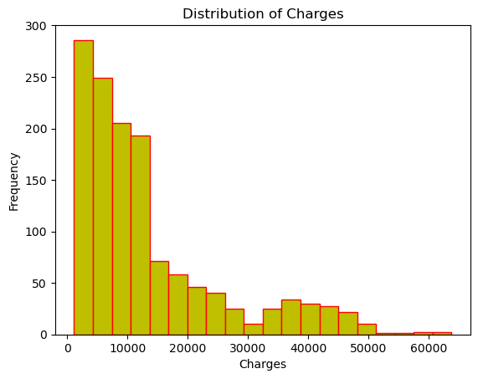
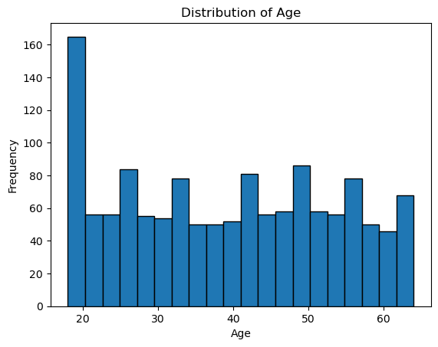
Visualize the distribution of numerical variables such as 'age,' 'bmi,' and 'charges' using histograms
© All rights reserved by Fireblaze Technologies Pvt. Ltd.

Slide 9
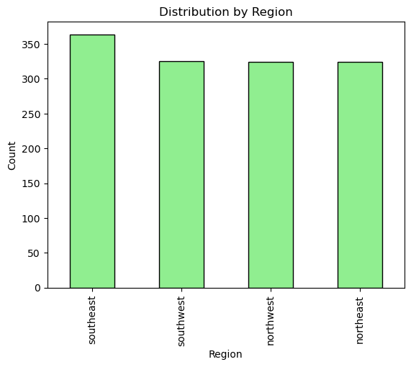
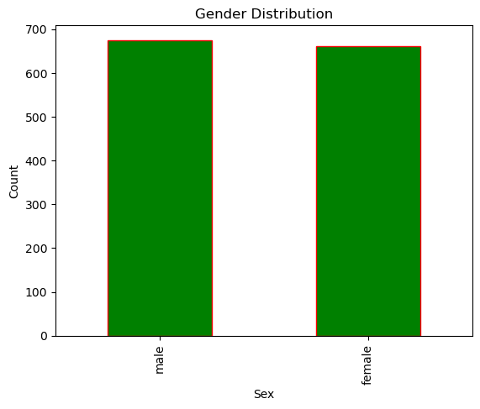
Create bar charts to visualize the distribution of categorical variables like 'sex,' 'smoker,' and 'region
© All rights reserved by Fireblaze Technologies Pvt. Ltd.

Slide 10
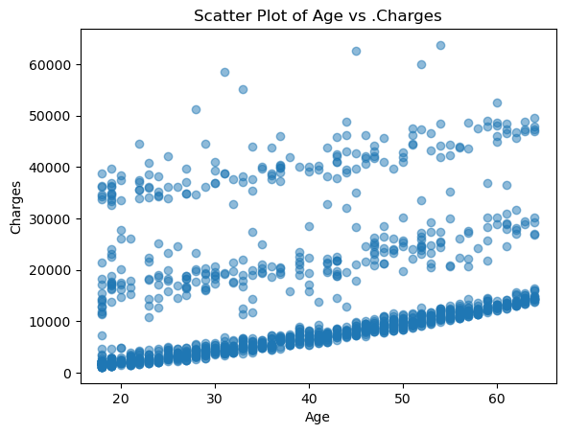
'age' vs. 'charges.
relationship between age and insurance charges.
If points tend to cluster in a certain way (e.g., they form a diagonal line), it may indicate a positive or negative correlation between the two variables. In this plot, you can see that as age increases, charges also tend to increase. This suggests a potential positive correlation.
© All rights reserved by Fireblaze Technologies Pvt. Ltd.

Slide 11
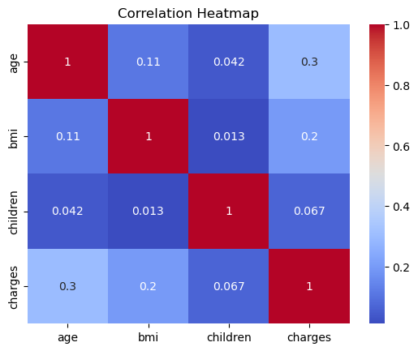
If 'age' and 'charges' have a correlation coefficient of 0.3, it suggests a weak positive correlation between age and insurance charges. As age increases, insurance charges tend to increase slightly. If 'bmi' and 'children' have a correlation coefficient of -0.03, it indicates little to no linear relationship between BMI and the number of children.
Correlation Analysis
© All rights reserved by Fireblaze Technologies Pvt. Ltd.

Slide 12
Optimisation
Gender Distribution: The dataset has a relatively balanced distribution of genders, with a similar count of 'female' and 'male' individuals.
Smoking Habits: A significant portion of individuals in the dataset are non-smokers ('no'), while a smaller percentage are smokers ('yes').
Regional Distribution: Individuals are distributed across four regions: 'northeast,' 'northwest,' 'southeast,' and 'southwest.' The dataset provides representation from different geographic areas.
© All rights reserved by Fireblaze Technologies Pvt. Ltd.

Slide 13
Conclusion
Age Distribution: The age distribution in the dataset spans a wide range, with individuals ranging from young adults to seniors. The distribution appears relatively uniform, with no strong skewness.
BMI Distribution: The distribution of Body Mass Index (BMI) values varies, with a range of values from underweight to obese. The distribution is somewhat right-skewed, with more individuals having higher BMI values.
Insurance Charges: Insurance charges vary significantly across individuals, with some individuals having low charges and others having very high charges. The distribution of charges appears to be right-skewed, with a few individuals incurring exceptionally high costs.
© All rights reserved by Fireblaze Technologies Pvt. Ltd.

Slide 14
Future Scope
Data Expansion: Expanding the dataset with additional relevant data, such as medical history, lifestyle factors, or socioeconomic data, to provide a more comprehensive view of health insurance charges.
Data Visualization and Dashboards: Creating interactive data visualizations and dashboards to make the analysis results accessible and understandable for a broader audience.
Healthcare Policy Analysis: Investigating the dataset's implications for healthcare policy decisions and assessing the impact of policy changes on insurance charges
.
© All rights reserved by Fireblaze Technologies Pvt. Ltd.

